Slide 1
Rate My Apartment
Julian Gonzales, Faizah Kolapo, Sara Roshan

Slide 2
Project Idea & Why, What, Who
Rate My Apartment is a website/app that allows people to view and read reviews of apartments in their area
There are limited resources when looking for an apartment so we thought this would be helpful to many who are looking for such resources
Targeting specifically the city of Regina and its community for now hoping to be able to expand in the future

Slide 3
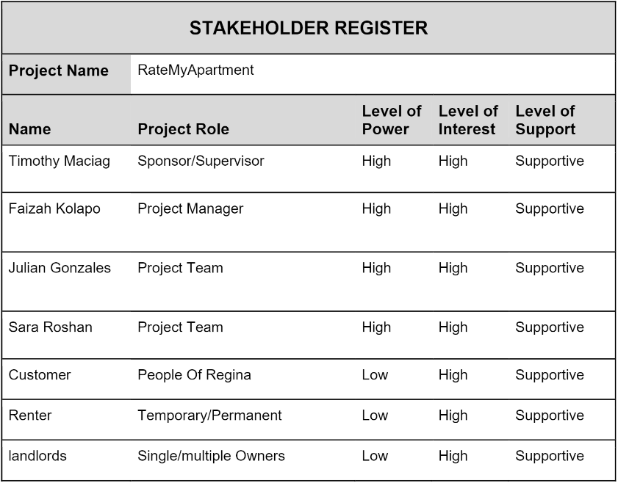
Stakeholder Register

Slide 4
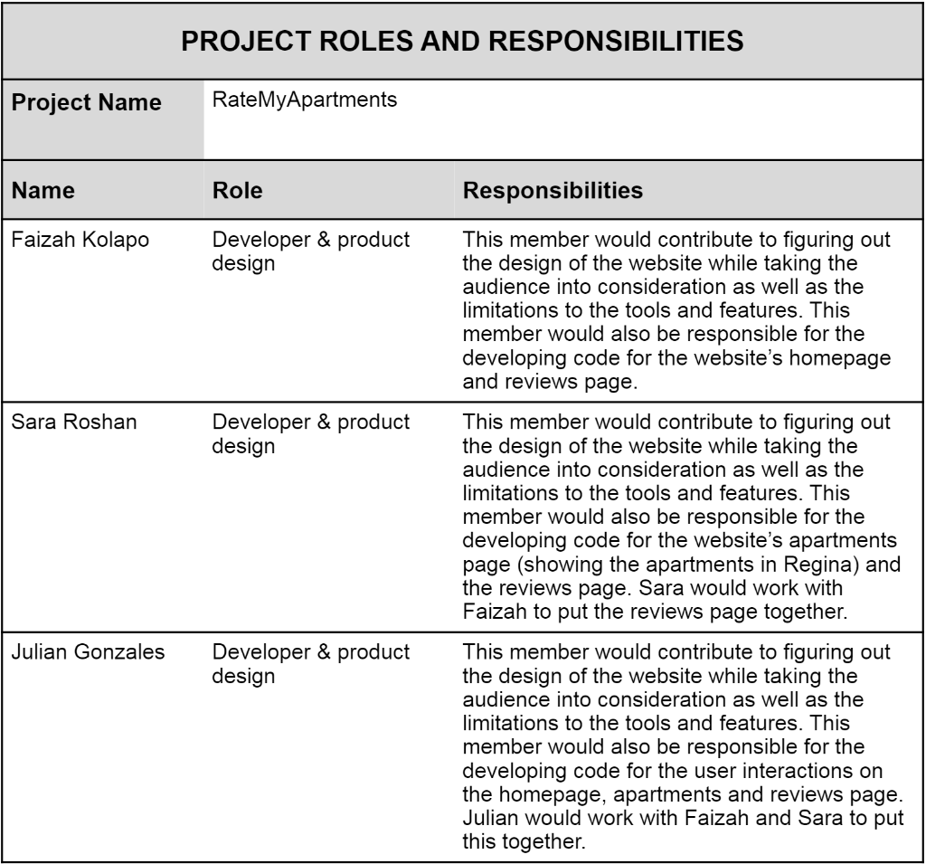
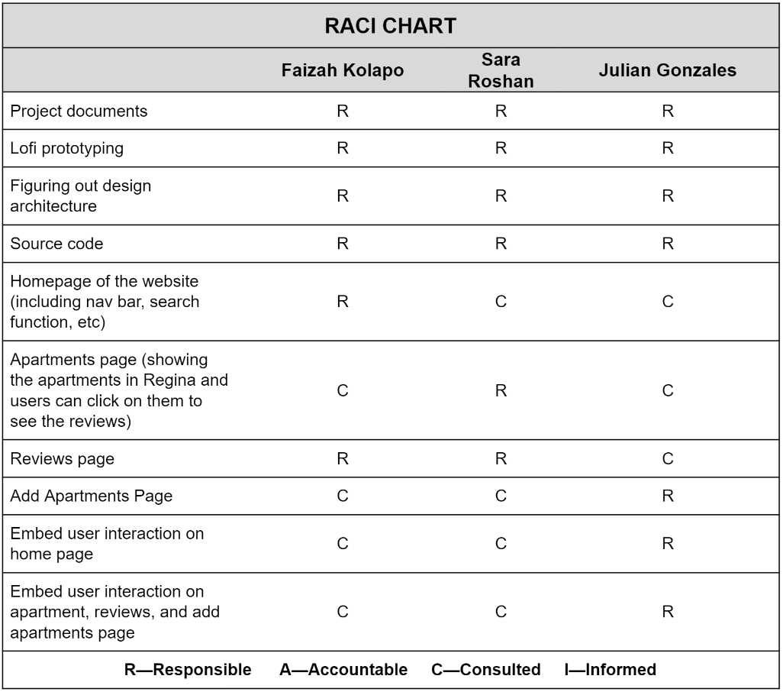
Team Roles & Responsibilities
All members started out with the same roles and responsibilities
We further detailed those responsibilities using a RACI chart

Slide 5
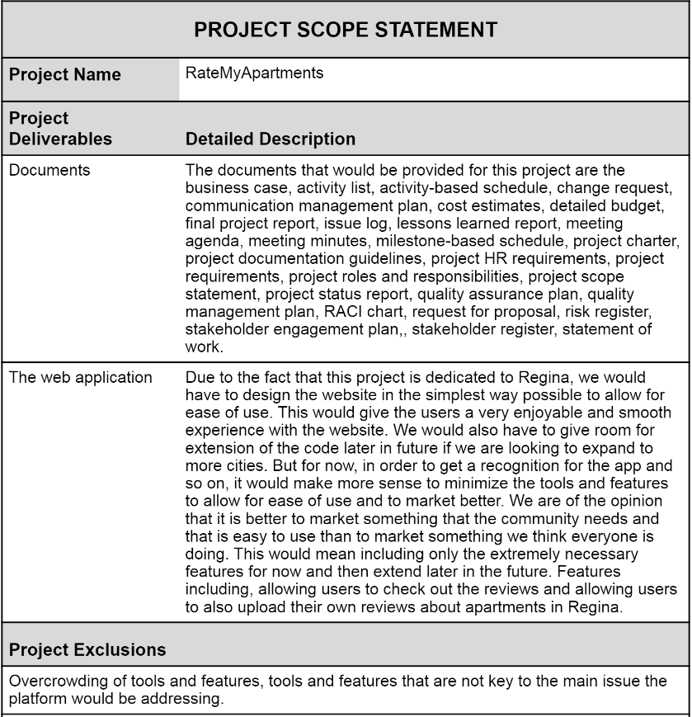
Project Scope
Focusing the project for the city of Regina allows a more feasible target but also for extension in the future
Minimizing extra tools and features to allow ease of use and simplicity and addresses the main problem

Slide 6
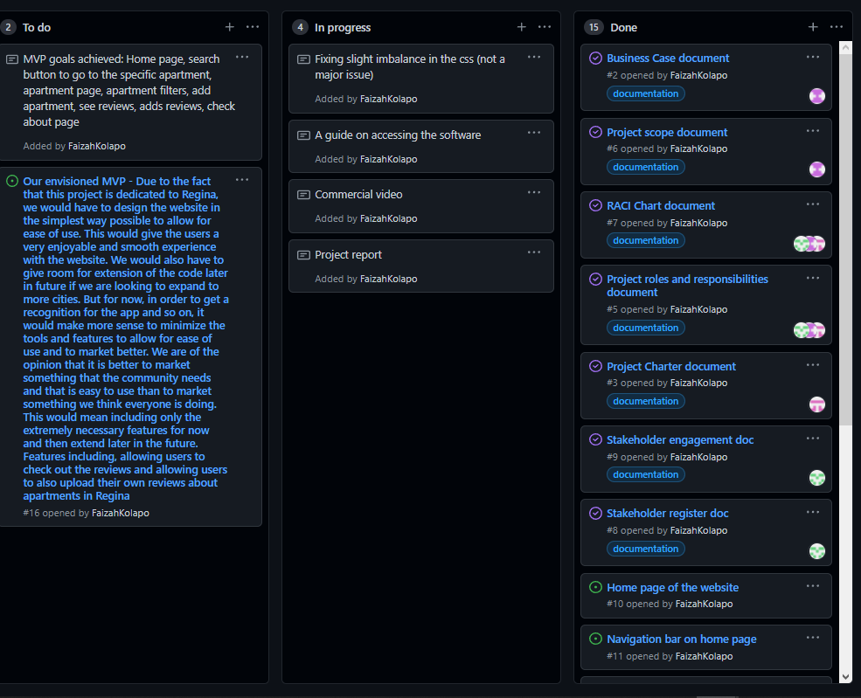
GitHub & KanBan
Helpful, but was not used very much

Slide 7
Project Comments
Concerns about tenant review and landlord reviews
Since the focus of this website are for other people to see previous/current tenants living situation we did not see the need to add landlord reviews
Other than that, most comments were about some tweaks in our Kanban/Github

Slide 8
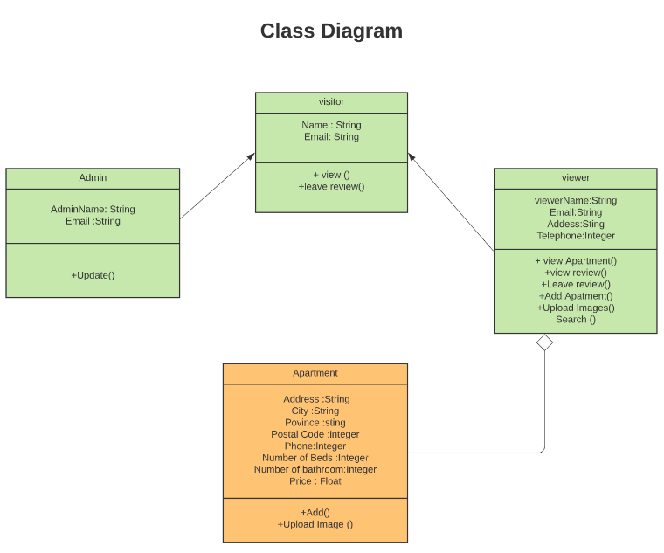
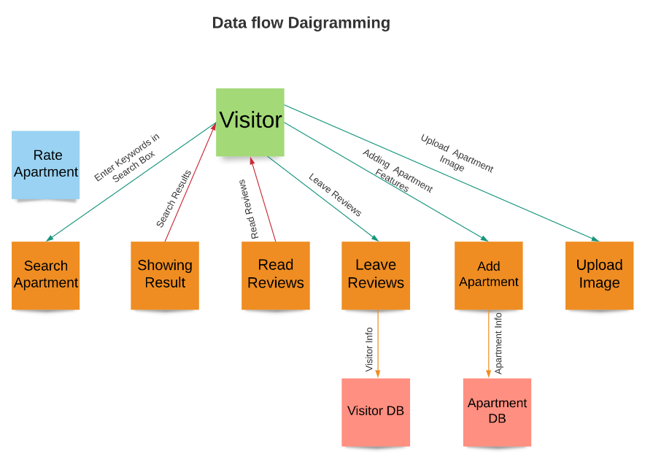
UML Diagrams
We outlined what functions the client and server will have and how they all connect to each other

Slide 9
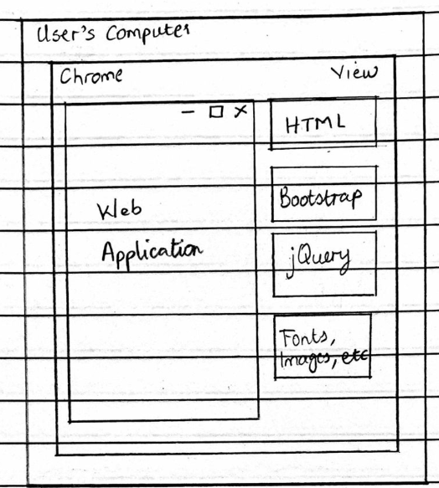
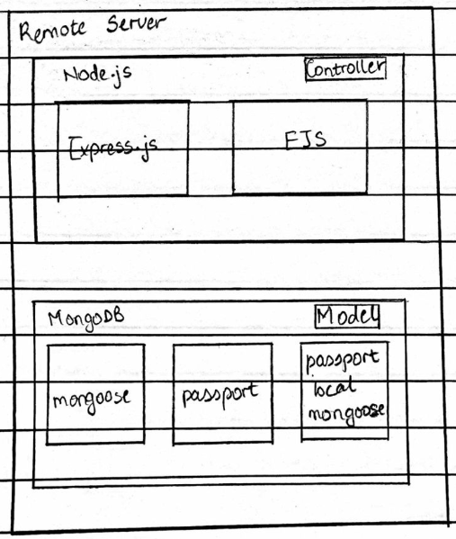
MVC Architecture

Slide 10
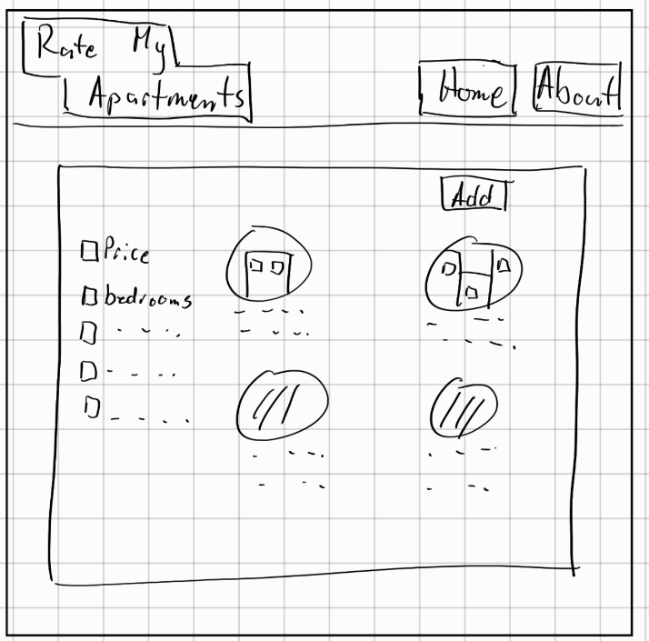
Low-Fidelity Sketches
We tried to recreate the sketches into HTML as true as possible but some things were changed simply because of forgotten functionalities or convenience

Slide 11
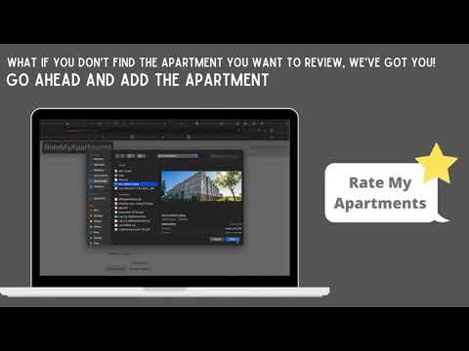
Commercial video

Slide 12
Team Reflection
How did you feel about this project? Do you think your team was successful, or? What did you like about the project? What did you dislike about the project?
What did your team feel most proud of throughout the entire project?
What did you learn about yourself as you worked on this project (Individually and as a team)
How will you use (or not use) what you have learned/experienced in this project going forward?
What “stuff & things” related to this project would you like more help with?

Slide 13
Questions

